Slide 1
Process of Screening: Lab to Clinician
Sarah Smith
Consultant Clinical Scientist

Slide 2
Overview
Sample/lab timelines and processes
Referral pathway
Outcome data
KPI data for 2021/22

Slide 3
Baby to lab: Sample timeline
Sample taken on day 4-5
Up to 3 working days to reach the lab
If the sample takes over 14 days to reach the lab we ask for it to be repeated.
By the time the sample is received the baby could be between 4- 10 days old if all timeline targets are met.
We will process any sample received on a baby up to 1 year old.

Slide 4
Lab timelines
Samples received are processed overnight
Negative results are reported within 1 working day
Raised levels retested in duplicate
Raised results or borderline results are reported within 2 working days
Lab turnaround time is 2 working days
Should we refer on a Saturday?

Slide 5
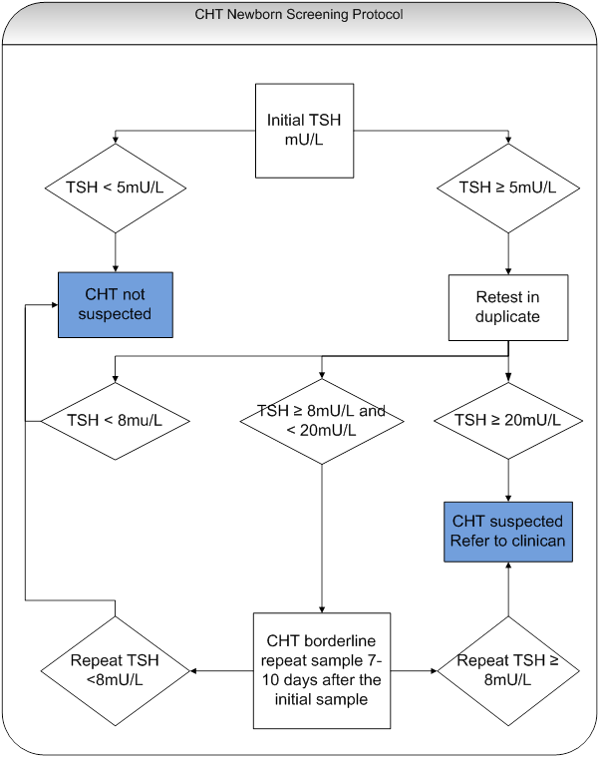

Slide 6
Preterm babies
Babies born ≤ 32 weeks gestation require a repeat sample at day 28 of life or discharge home
Day of birth = day 0
The 28 day repeat is treated like the first sample.
If the routine newborn sample (day 4-5) is positive then the referral pathway is followed and a 28 day repeat is not needed

Slide 7
Referral Pathways
First sample positive (≥20mU/L)
First sample borderline (≥8, <20mU/L), repeat sample positive (≥20mU/L)
First sample borderline (≥8, <20mU/L), repeat sample borderline (≥8, <20mU/L)

Slide 8
Referral Process
2 designated Clinicians for each Health Board
In some cases an alternative contact is used
If designated Clinicians cannot be reached (e.g. public holidays) then the on call paediatrician will be called.

Slide 9
Confirmation of baby seen
If an alternative to the designated Clinician is called then the lab will talk to the designated Clinician at the next available opportunity (call or email) to ensure they are aware of the baby.

Slide 10
Paperwork
Referral letter will be sent by post or email as soon as possible
A copy is sent to the designated Clinician and the person who the referral was made to if these differ.
A reply slip is sent to provide us with the details of when the baby was seen (this information can be emailed).

Slide 11
Outcome data
Who?
UK National Screening Committee
Scottish Screening Committee via NSD
All Scottish Health Boards
Why?
Monitor lab performance
Monitor health board performance
Monitor the screening programme
Submitted yearly for all referred babies

Slide 12
Outcome data
Gender
Ethnicity
Gestational age at birth
TSH referral pathway

Slide 13
Outcome data
Age when sample was taken
Age when sample was received
TSH level of all samples
Age at referral
Age when seen by clinical team
Confirmatory results
Serum TSH
Free T4
Likely outcome –True/false positive
Was Thyroxine prescribed?

Slide 14
Proposed changes to outcome data
New initiative from UK NSC
Collect thyroid gland position
Collect clinical data once permanent vs transient CHT has been established
Lab will retain the annual submission and resubmit after 4 years
BUT clinical teams will need to provide the data to the lab

Slide 15
KPI data (2021-22)
89.6% samples taken on day 4-5
88.6% samples reached the lab within 3 working days
99.7% results reported within 2 working days
82% TSH borderline repeat samples taken at correct time (7-10 days after the first)
64% preterm babies have their repeat sample taken on day 27/28 or discharge.
100% CHT positive babies referred within 2 working days

Slide 16
Lab outcome data(2021-22)
Referral pathway | Number of referrals | On Thyroxine | Not on Thyroxine
1st sample positive | 18 | 12 | 6
1st sample borderline, repeat positive | 4 | 4 | 0
Double borderline | 9 | 7 | 2
Preterm sample positive | 0 | n/a | n/a
Preterm sample borderline, repeat positive | 0 | n/a | n/a
Preterm sample double borderline | 2 | 1 | 1
Total | 33 | 24 | 9
Notes:
1 layered sample
2 very sick babies with multiple morbidities
3 unknown

Slide 17
Clinical outcomes data (2021-22)
30/33 referred babies were seen by a clinical team on the same or the following day.
1 baby seen 3 days after referral
2 babies seen 4 days after referral

Slide 18
Timeliness into care (2021-22)
1st sample referrals should attend first clinical appointment by day 14 of life.
All except 1 baby achieved this standard (the delay for the 1 late baby was late initial sampling. The baby was seen on the same day as the referral)
2nd sample referrals should attend first clinical appointment by day 21 of life.
10/13 attended the first clinical appointment by 21 days of age (delay was in all cases late sampling of either the first or repeat sample)

